Slide 1
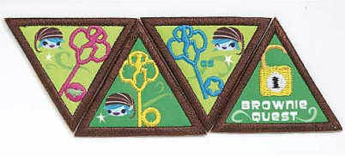
Brownie Quest Journey
Presentation of this Journey:
The Brownie Quest Journey is scripted for LIA training or Leader presentation.
The girls must be trained and given the presentation a week or two in advance to help them prepare. We have opted to prepare a starting script for the LIA’s. If they want to add or revise without changing the main point, that is o.k. They should certainly feel free to present their section in their own words….we discourage reading; but reading is better than not participating. We are providing a script to the girls as we found the journeys are difficult to condense and prepare on their own. As they grow in Girl Scouts and get more experience presenting journeys, preparing their own presentation is certainly recommended.
The presentation can be edited to fit your troop’s needs.

Slide 2
Brownie Quest
Date: Month, Date, Year ; Time 10:00 – 2:00pm
Location__________________
9:45 – 10:15am Registration
Brownies receive Name Badge and Team Assignment (If you have a class rotation – We had four rotations)
Teams:
Key Chain Team
Florida Keys Team
Keyboarding Team
Key Card Team
10:15am – 10:30am Opening Ceremony
Pledge and Promise
Sing Song – Select a couple songs – The Cadettes can lead.
Adult Leaders – Explain Purpose of today’s journey – Introduce LIA’s – If presenting with LIA’s
Rotation:
Call out each team one at a time – proceed to class room
Each room should be named or numbered.
10:30am – 11:10am – First Key Class “Discover”
11:15am – 12:00N – Second Key Class “Connect”
12:00N – 12:45pm – Lunch (Provide lunch or have the girls bring a sack lunch)
12:50pm – 1:30pm – Third Key Class “Take Action”
1:30pm – Start Closing
Each team will need to sit together so they can present a statement from their team agreement and take action idea.
Each Brownie will earn their LOCK in Closing - Hand out to girls, or have them find it. We put in a bag as the center piece on the table. Make a necklace out of the lock so they can wear with the three keys.
Hand out Certificates (Girl’s and LIA’s)
Journey ends!!

Slide 3
Brownie Quest Journey
Supplies Needed
Brownie Quest Girl and Adult Guide
3 Keys – Discover, Connect and Take Action. See Appendix
Yarn – To use for Key Necklace (Black); any other color will work to tie key onto black necklace yard.
Small Ball – Nothing too hard
Blank Paper Sheets (For gluing pictures)
Ink Pens or Pencils for each girl
Brownie Quest Map – See in Adult Guide (See Example in Appendix)
Brownie Quest Map Sheet for Discover, Connect, Take Action Keys. See Appendix
Brownie Team Agreement – See Appendix (Pg 53 Girl’s Bk)
Discovering Family Star– See Appendix (Pg 51 Girl’s Bk)
GS Law – Signs to Law – See Appendix
Keys – Law – See Appendix
Poster Board or Construction Paper (Take Action Notes)
Pipe Cleaner Wire – or Chanelle Wire (same thing)
Hula Hoops (1 or 2) for Loop the Hoop game
Campbell Cares – See Appendix (Pg 54-55 Girl’s Book)
Circle of Caring – See Appendix (Pg 60 Girl’s Book)
The Brownie Brainstorm – See Appendix (Pg 66 Girl’s Bk)
Lock – See Appendix

Slide 4
1st Key – Step 1
(All Cadettes stand up in front of the class while you’re speaking. Otherwise there will be chairs on the side for you to have a seat while someone else talking. Then when it’s time to do the craft for each session, you can go around and help the Brownies)
Do not pull your cell phones out and text, check e:mail, facebook, etc during class time.
All Cadettes – As the Brownies arrive, welcome them to your class. After the first rotation, you may want to ask them what did they learn in the class they just had. Helps to get conversation going.
Cadette ________________ says:
You are about to start a special Quest, which is a journey, to find out what it means to be a leader.
Cadette ________________ says:
Today, by the time you leave, you should be able to understand your own skills, learn how to be a team member, decide how our community can be helped and inspire others along the way.
Cadette ________________ says:
You will earn 3 keys and there are 3 steps we have to take to find each key. At the end of our journey today your keys will unlock your being able to Make the World a Better Place.
Cadette ________________ says:
So let’s begin. The first step is to DISCOVER all the skills and talents and qualities each of us brings with us on our Quest. So, we are going to toss a ball around our circle (that we’re about to make). You’ll say your name and one special skill or talent you would like to bring to the team.

Slide 5
Cadette ________________ says:
Lets make a circle big enough we can have a little space in between each of us.
Cadette ________________ says:
I’ll start, My name is ____________________ and I have a lot of energy, so I never give up! Now it’s your turn. . .
Toss the ball to the next person and then the next
One of the Cadettes will need to have paper and pin to write down the quality each girl mentions. You don’t have to put their name, just what they say.
Praise them for having so many great talents. If you have time before the class is over, you can go back to these qualities and read them out.
Cadette ________________ says:
Wow, you girls did great. I see we have a lot of talented young Brownies on this journey.
Cadette ________________ says:
Every one now needs to take your pencil and your Brownie Quest Map out of your folder. You just earned Step 1 to the first Key, so let’s write “Discovering our Talents” on your map. (Show a poster with the words, so the girls will know how to spell. Cadettes can go around the room and help also).
1st Key – Step 2
Cadette ________________ says:
Now it’s time for the second step! We want to discover the values of the Girl Scout Law.
Cadette ________________ says:
How many of you know the Girl Scout Law by heart? Each line of the Girl Scout Law represents a value. Can anyone tell me what is a value? (let them answer and give positive feedback for speaking out) It’s something we believe is important and we try to live by.

Slide 6
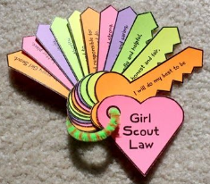
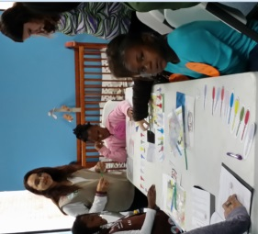
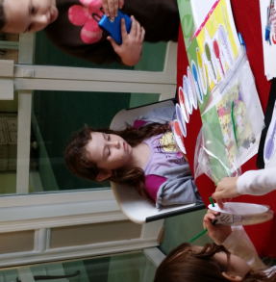
Cadette ________________ says:
Our values are part of what makes us special – just like all the talents you shared in the Brownie circle.
Cadette ________________ says:
So, this is what we’re going to do. First, we want everyone to stand and let’s say the Girl Scout Law. If any of you know the signs, we can do the signs.
Cadette ________________ says:
Great job girls – Next, our Cadette are going to give each of you a set of keys. On each key is a line from the Girl Scout Law. Put them in correct order and then we’ll give you something to make a ring to keep them together.
Cadette ________________ says:
While we’re doing this, we want to go around the room and you tell everyone which line of the law is special to you. They are all special, but today we want to pick one so everyone can have a turn. Ok, we’ll start with you . . .
Go around the room and get their thoughts on the law
1st Key – Step 3
Cadette ________________ says:
Now it’s time to look at the last step in earning today’s first Key call “Discovery”. Look at the “Discovering Family” star in your binder.
Cadette ________________ says:
When you get home, explain the Girl Scout Law to your family members and ask them which value would they select as being really, really important in your family. Write those under their name and keep this as something to be proud of you family.

Slide 7
1st Key – Step 3
Cadette ________________ says:
We have completed Step 3, now write on your map “Discover Family Values”
Cadette ________________ says:
Congratulations, you have earned the “Discover” key. This will be a necklace that you’ll put together as you go through the Brownie Quest. You have 2 more keys to earn and then in the closing you’ll earn the lock.
Cadettes start handing out the necklace (black yarn) and tie on the “Discovery” key (tie on using the rainbow color yarn). Leaders, we put the black yarn around the girl’s neck and as they earned the three keys, tie the keys to the black yarn. Use another color yarn for the three keys.
Cadette ________________ says:
Now repeat after me:
The Discover Key
It’s all about me:
What I believe
And my family.
It should be time for the girls to switch to their next class

Slide 8
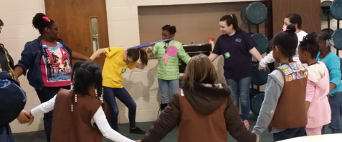
2nd Key – Step 1
Cadette ________________ says:
Welcome everyone! Which key did you earn in your last class? (Brownies answer) Now that you have found the “Discover Key”, you can move ahead and find the second key. Is everyone ready? How many steps are there to find each key? (three)
Cadette ________________ says:
The first step in finding the second key is to practice our Brownie Team Skills. When we join together, we make a strong team. This game is going to help us think about how we need to act together to be a great team.
Cadettes need to decide if you have room in your room or if you prefer to step out into the gym as it’s the “Loop the Hoop” game
Cadette ________________ says:
Everyone needs to stand in a circle, holding hands
Hang a Hula Hoop over one player.
While holding hands, the girls pass the Hula Hoop completely around the circle without letting it touch the ground
After the game is over (ok to play twice if your game moves fairly quickly) return to room
Cadette ________________ says:
What are some of the things you did to help each other pass the Hula Hoop?
Did you need to trust each other? Why? Was that hard or easy?
Cadette ________________ says:
What happens on a team if someone makes a mistake? Do we want that person to feel bad? What can we do?
Cadette ________________ says:
What makes being on a team together fun? What would make us feel bad about being on a Brownie team together

Slide 9
Cadette ________________ says:
Strong teams have Team Agreements – or promises – about how team members get along together and cooperate.
Cadette ________________ says:
Today we need for you all as a team to make a Brownie Team Agreement. When we go to the closing to end our journey, we’ll need to tell everyone our team agreement - what you all agree is best way to describe a strong team. (If you only have one class, then possibly share with the parents at closing.)
Cadette ________________ says:
So, here’s a form for the Brownie Team Agreement (handout). What would you like to put to describe or words to make you a strong team? Everyone will need to agree and then you write it down. You can have more than one, but you’ll just need to select one to say to the group at the end today.
Cadette ________________ says:
Has everyone completed the agreement and you all agree on the some thing? Very good. Now you’ve finished Step 1 to the 2nd Key. Take out your map and write on the Step 1, Key 2 “Brownie Team Agreement”
Cadette ________________ says:
Our Team Agreement shows how you care about and connect to each other. Who else do you care about? Showing our families we care about them is really important! So you are going to take the second step to finding the second key with your families.
Give out Handout (Pg 54.55) Campbell Cares
Cadette ________________ says:
Give Campbell some ideas for leading her family to feeling better.
(discuss the handout – can write in answer or verbally if you run close on time because you have the Circle Map to do next)
Cadette ________________ says:
Let’s look at our map and write in “Connect Family” on Step 2 of the 2nd Key

Slide 10
Cadette ________________ says:
Now, let’s look at Step 3 of the 2nd Key – Let’s make a Circle Map. We’re going to hand out a circle map to each of you. You are in the Center because your life grows outward – Me, Family, Girl Scouts, Community and World. (explain map and for the girls to write in each circle as you review)
Cadette ________________ says:
Completing the Circle Map shows how we connect with others and try to help and show our community we care. Let’s put on our map for Step 3 – “Connect with Others”

Slide 11
3rd Key – Step 1
Cadette__________________________says:
Ready to work on your third key?
Let’s look at your Quest Map and see the progress you’ve made. You’ve found the Discover Key and the Connect Key. Now it’s time to start on the third key.
What do you think the name of the third key is? (Give girls a change to answer)
It’s the TAKE ACTION key!!!
Cadette__________________________says:
Our First step toward earning the third key is figuring out who needs some help from our Brownie Team. Where can we Fly into Action and make the World a better place.
Cadette__________________________says:
Let’s think about all the places in our neighborhood where people might need us to do something for them.
(PUT WHITE POSTER PAPER ON TABLE – GIRLS CAN WALK AROUND THE TABLE – OR HOWEVER WORKS BEST)
Now we need to figure out who might need our help and what we can do. I want you to get your pen and write ideas on the paper of what you would like to do to help somebody or help them do something. Think about places people work and the help they might need. For example, Kid’s Nursery, Schools, Library, Hospital, Food Pantry, Fire Station, Playground, Park etc.

Slide 12
3rd Key – Step 1 Cont’d
Cadette__________________________says:
Now that you’ve written down your ideas, you get to vote. Each one of you will get three votes. You need to look at all the ideas on the paper and put a “Tic” mark by three of the ideas that you like best. Then we’ll see which one gets the most votes. If we have a tie, we’ll discuss the two left and vote again.
You will announce your project during closing.
3rd Key – Step 2
Cadette__________________________says:
Step 2 is Plan your Project. You selected_________________as your project. Your leaders will assist you since you are 2nd and 3rd graders.
What kinds of questions should you ask to get you project going?
What type of supplies will you need?
Will you need help other than your team?
How long do you think this project will take?
What do you think can be accomplished with this project?
Cadette__________________________says:
Planning and preparing is the 2nd step to your last key. What is this key called? The Take Action key.
(Hand out Take Action key to put on their necklace.)

Slide 13
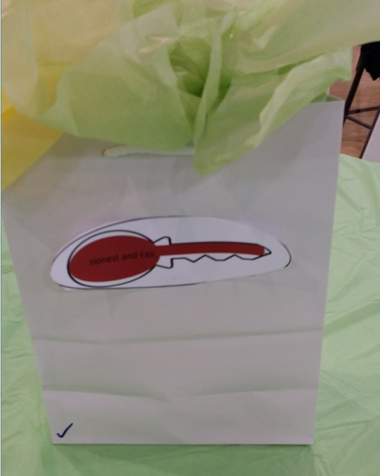
3rd Key – Step 3
Cadette____________________says:
The first two steps were to identify a problem we care about and plan an action. So the last Step is ACTUALLY DOING IT!!! Or Take Action.
(Add the “Take Action” Key to their Necklace.)
CLOSING
Each team will need to sit together so they can present a statement from their team agreement and take action idea.
Each Brownie will earn their LOCK in Closing - Hand out to girls, or have them find it. We put locks in a bag as the center piece on the table. Make a necklace out of the lock so they can wear with the three keys.
Hand out Certificates (Girl’s and LIA’s)

Slide 14
Resource
Appendix

Slide 15
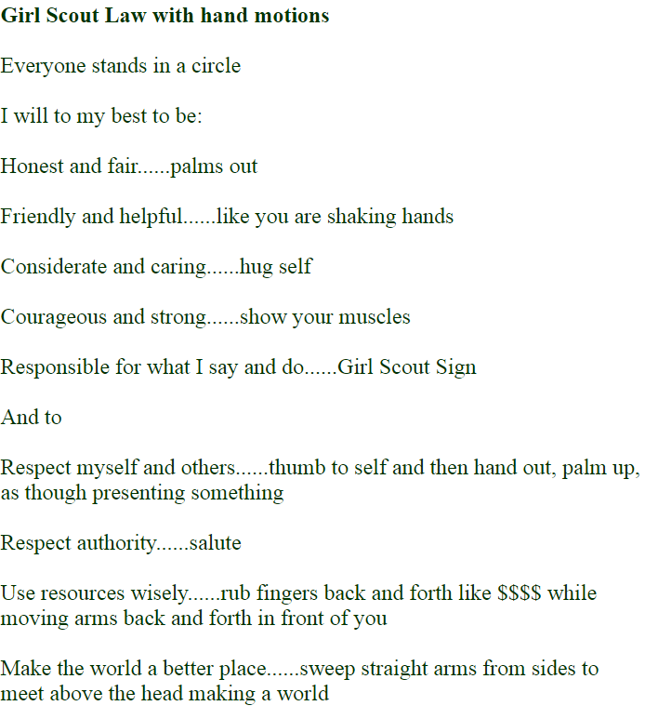

Slide 16
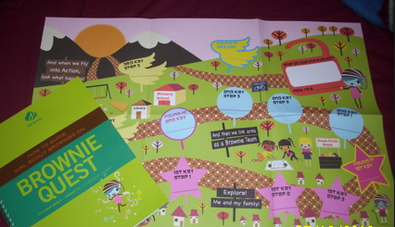
Brownie Quest Map – See Adult Guide.
Use the Brownie Quest Steps 1-3 Sheet to fill in Answers

Slide 17
Brownie Quest – Steps 1, 2 & 3
To Find the Discover Key:
1st Key Step 1____________________
1st Key Step 2____________________
1st Key Step 3____________________
To Find the Connect Key:
2nd Key Step 1____________________
2nd Key Step 2____________________
2nd Key Step 3____________________
To Find the Take Action Key:
3rd Key Step 1____________________
3rd Key Step 2____________________
3rd Key Step 3____________________

Slide 18
I will do my Best to Be:
Courageous and strong, and
Honest and Fair,
Friendly and Helpful,
Considerate and Caring,

Slide 19
Responsible for what I say
Make the world a better place,
And do, and to
And be a sister to
Respect myself and others,
Every Girl Scout.
Respect authority, use resources
wisely,

Slide 20
Discover
Connect
Take Action

Slide 21
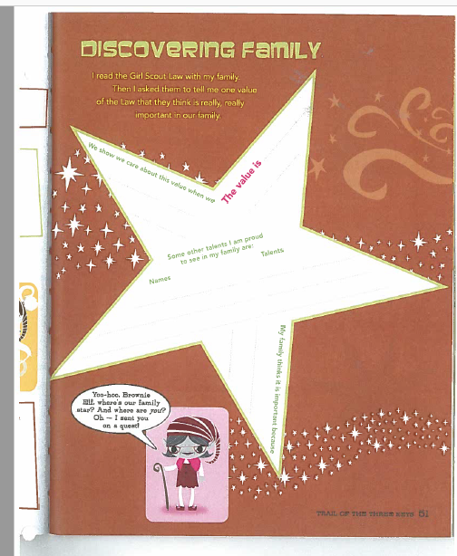

Slide 22
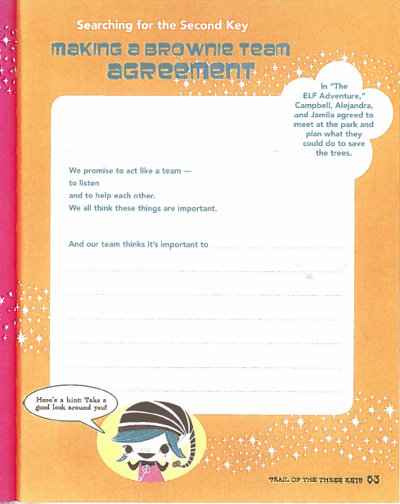

Slide 23
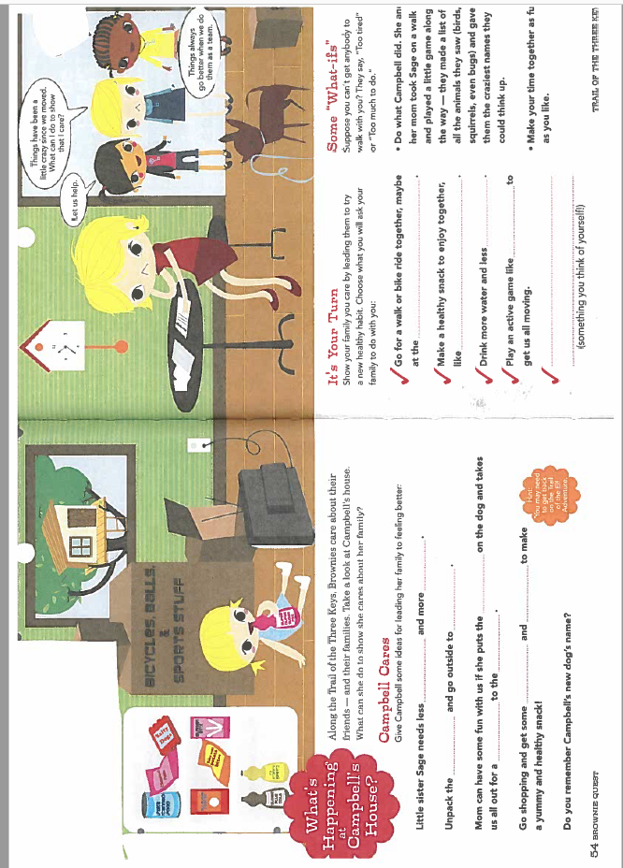

Slide 24
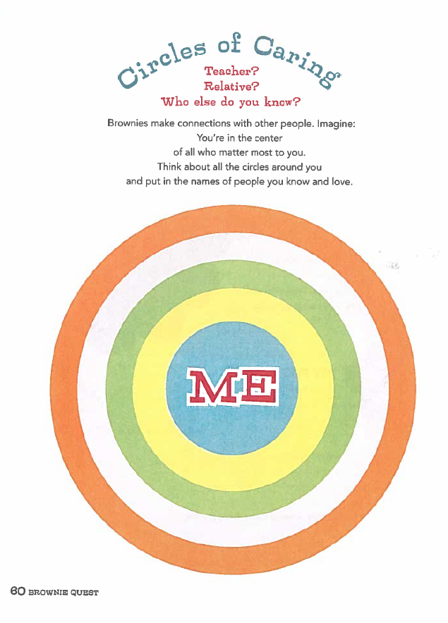

Slide 25
