Slide 1
World of Girls Journey

Slide 2
World of Girls Journey
Presentation of Journey:
The World of Girls Journey is scripted for LIA training or Leader presentation.
The girls must be trained and given the presentation a week or two in advance to help them prepare. We have opted to prepare a starting script for the LIA’s. If they want to add or revise without changing the main point, that is o.k. They should certainly feel free to present their section in their own words….we discourage reading; but reading is better than not participating. We are providing a script to the girls as we found the journeys are difficult to condense and prepare on their own. As they grow in Girl Scouts and get more experience presenting journeys, preparing their own presentation is certainly recommended.
The presentation can be edited to fit your troop’s needs.

Slide 3
World of Girls Journey
Date___________________
Location________________
Time: 10:00am – 2:30pm
Schedule
10:00am – 10:30am
Opening Ceremony in Gym
- Sign in, pick up folder for the day
- Pledge and Promise
- Explain Rotation (Adult in each class will take group to next class at rotation time. Cadets stay in the room to greet new group)
10:35am – 12:15pm Class Rotations
12:20pm – 12:50pm Lunch – Gym
12:55pm – 2:00pm Class Rotations
2:05pm – 2:30pm
Closing Ceremony
- Thank everyone for coming
- Recognize Cadets – Give out LIA Badge
- Brownies will receive WOG Badges from Troop Leader
- Sing Silly Song and “Make New Friends”
- Have volunteers demonstrate dance from Countries or play games waiting on parents. (If have extra time)

Slide 4
Rotation Schedule
 | Opening | Jordan (Heather, Madison, Christine) | Thailand (Tracey, Milann) | Arctic Canada (Aubrey, Bethann) | World of Girls Tell a Story (Faith, (Jeanine) | Games (Kristen, Ava Melba) | Closing | Lunch (Melba/all)
10:00-10:30 | ALL |  |  |  |  |  |  | 12:20-12:50pm Everyone together
10:35-11:05 |  | Yellow Team | Pink Team | Blue Team | Orange Team | Purple Team
11:10-11:40 |  | Purple Team | Yellow Team | Pink Team | Blue Team | Orange Team
11:45-12:15 |  | Orange Team | Purple Team | Yellow Team | Pink Team | Blue Team
12:20-12:50 | Lunch | Lunch | Lunch | Lunch | Lunch | Lunch
12:55-1:25 |  | Blue Team | Orange Team | Purple Team | Yellow Team | Pink Team
1:30-2:00 |  | Pink Team | Blue Team | Orange Team | Purple Team | Yellow Team
2:05-2:30 |  |  |  |  |  |  | ALL

Slide 5
Supply List:
Brownie Guide and Adult Book
Journal Book or Folder with blank sheets of paper. About six sheets. Folder with pockets work best.
Country Flags – See Appendix
Map for each country – See Appendix:
World Map for Wall or Globe **
Pictures from each Country – See Appendix
Fig Newtons (for girls to taste) or any type fig snack. (Jordan)
Picture of Mansaf – See Appendix, Coloring Sheets ( Jordan Sand Craft)
Salt & Colored Chalk (Jordan Sand Craft)
Pencils
Medium Size Paper Plates ( Arctic Canada)
Glue Sticks
Push Pins (For World Maps)
Sugar & Blueberries (Arctic Canada)
Colored Jello Optional
Plastic Knives (Arctic Canada)
Dowel or Sticks for Fishing Poles (Arctic Canada)
Crape Paper for Fishing Line (Arctic Canada)
Medium White Paper Plate for Fishing Hole (Arctic Canada)
Pretend Gifts (Thailand)
Pineapple snack (Thailand) Serve in small cup with fork and napkin.
**If you use a Globe to show the girls the country locations, have them each go up and look.

Slide 6
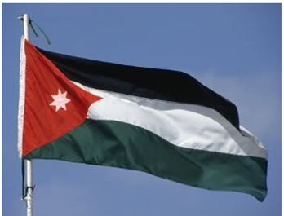
Welcome to
Jordan

Slide 7
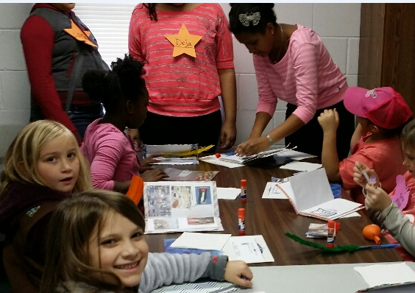
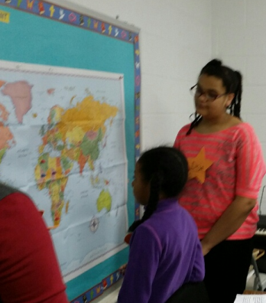
CADETTE_______________________
(Complete Journal information – Paste Flag and
pick out picture for Jordan – Can use Journal Books
Or Folders with sheets of paper.)
Say: Welcome. The Bookmobile has landed in a
country called Jordan.
Say: Let’s Find Jordan on the World Map. (Point to the map on the Wall)
Where do you think it is located on the Map?
Say: Jordan, is an Arab country in the Middle East. It is a little smaller than Indiana and borders the countries of Syria, Iraq, Saudi Arabia and Israel.
CADETTE_______________________
(HAVE ONE OF THE GIRLS TO COME UP AND PLACE A PIN
ON THE COUNTRY JORDAN)
Say: When we look at Jordan, Western Jordan is the only region where crops can grow as it is close to the Jordan river. The eastern and southern parts are desert, with fewer than two inches of rain a year.

Slide 8
CADETTE_______________________
Say: Arabic is the official language, but most people speak both Arabic and English. People often greet each other by saying, “Peace be upon you” and the response is “and upon you be peace”.
Have the girls practice speaking to each other. Pair up the girls and have them speak to each other: “Peace be upon you” and respond with “and upon you be peace”.
Say: The biggest city is the capital city of Amman.
Say: Let’s now listen to a story from Jordan
CADETTE___________________________
Say: The Bookmobile has landed in a desert city of Amman, in the country of Jordan. We’re in a small park next to a tall apartment building. There is a little girl skipping out the front door. Hi…Peace be upon you, and upon you be peace she says. My name is Shali.

Slide 9
Cadette__________________________
Say: Shali is on her way to pick figs on her cousin’s farm. How would you like to taste a food made of figs?
Give each girl a fig newton to taste. You will probably prefer the fig newton to the main food in Jordan…Mansaf. Look in your folder for a picture of this dish.
Say: Let’s continue with our story. Our bookmobile has lots of books and reading is important. Shali said she has lots of books but has trouble reading them because the words are big and she has trouble understanding what they mean.
Ask the girls if they ever see words they don’t understand when they are reading?
Say: Maybe we can help with your reading problem. Let’s look in our bookmobile and see if we have some books that are just right for you. Shali said she wanted to be a good reader and read about plants. After giving Shali some books, Shali gave us all some figs to take home. It was really nice meeting Shali in the country of Jordan.

Slide 10
CADETTE________________________________
Say: You’ve heard the story of our friend Shali in Jordan. She has trouble reading and she wants to read about plants, but books about them are too hard for her.
Ask the Girls: What would you change in this story to make Shali’s world better?
CADETTE___________________________________
Say: Look in your folder and pull out your world map. Draw a line from Jordan to Brunswick, GA.
(If time permits, we added a sand art activity, as the desert is part of Jordan’s landscape. An easy suggestion would be take regular coloring sheets and put clue stick on the picture and cover with different colors of sand and shake off. You can also make your “sand” with salt and chalk. Put salt in a paper plate and rub the chalk over it several times changing the color. Put in a jar to use for the coloring activity.)

Slide 11
Welcome to
Arctic Canada

Slide 12
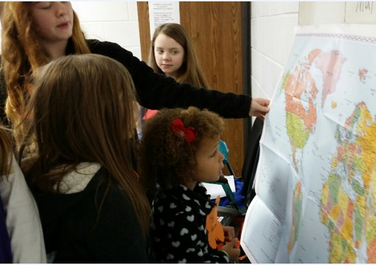
ARCTIC CANADA
CADETTE_______________________
(Complete information for Journal – Paste Flag and a picture of Country)
Say: Welcome. The Bookmobile has landed in Arctic Canada, in Northeastern Canada.
Say: Let’s Find Arctic Canada on the World Map. (Point to the map on the Wall)
Where do you think it is located on the Map?
(HAVE ONE OF THE GIRLS TO COME UP AND PLACE A
PIN ON ARCTIC CANADA.)
Say: Look at your world map and draw a
line and connect it from Arctic Canada to Brunswick, GA.
Say: Let’s visit a family in Arctic Canada. A sister girl guide, Lakti, is excited to tell us more about her family and where she lives. Instead of being called eskimos, they are called members of the Ungava Inuit. Lakti and her family and friends know many stories. Lakti said their family knew so many stores, it was hard to remember them.

Slide 13
CADETTE_______________________
Say: Storytelling was a way for the Inuit to pass the long, dark winters. Many stories were about the sun, moon, sea and animals. One storytelling tradition is known as storyknives. These are blunt knives Inuit fathers carved from bone or ivory for their daughters. The girls used the knives to draw pictures in the snow or mud to illustrate the stores they told.
ACTIVITY: We can’t draw in the snow or mud…but today we can draw a picture and tell a story with sugar as our snow. Give the girls a plate with sugar. Also give them a white plastic knife (to represent the storyknives) and ask them to draw a picture or pictures to tell their story. For color, the girls can add jello – We also added Blueberries. (Give the girls about 7 or 8 minutes to complete their drawing)
Say: Would anyone like to tell their story? (Give time for one or two girls to respond)
Say: People all over the world pass stories on to one another. Some do so by telling their stores aloud just as we just did with the sugar drawings…and some might sit around in a circle and tell their stores to one another just as girls scouts sitting around a fire. But instead of sitting around a fire, we are going fishing in the Hudson Bay in Arctic Canada that stays frozen all winter. Lakti is going to take us to a spot with a hold in the ice.

Slide 14
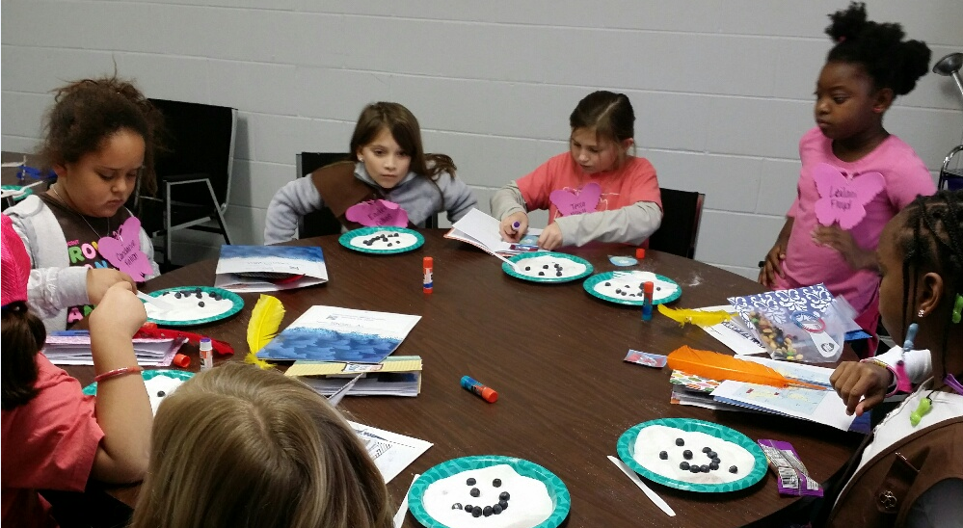
Tell a Story with Paper plates, Sugar, Plastic Knife and Blueberries

Slide 15
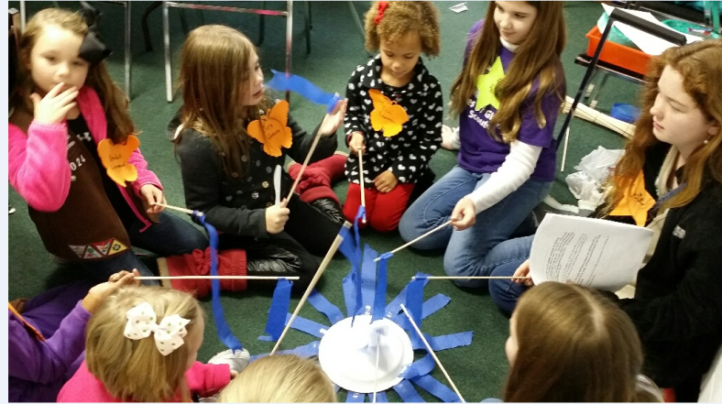
Cadette__________________________
Activity: Have the girls gather around the fishing containers and as they fish in their “ice hole”, tell the girls this is a good time to swap stories. Stories from long ago are often told out loud. These are called Folktales or made up stories from generation to generation. An example is “Little Red Riding Hood”
Ask the girls for a volunteer to either tell a story or have the girls start a story by starting with a sentence and go around to each girl to add a sentence and see what kind of story they create.
FISHING – The girls will have a dowel as a fishing pole as they sit around in a circle. A Paper plate works well to represent the ice hole.
The Girl Guides in Arctic Canada say thank you for visiting us today. Happy Stories.

Slide 16
Welcome to Thailand

Slide 17
World of Girls - Thailand
Cadette__________________________
Welcome! The bookmobile has landed here in Thailand. The Land of Smiles!! We have bananas hanging from big green leaves. Butterflies flying among the mango trees and papaya trees.
In Thailand, all schoolchildren wear uniforms. And each day, they place their lunches in the middle of the table and share their food. How would like to do that???
Some girls in Thailand work on their family’s farm. They plant and gather rice from the fields, feed and tend animals and collect eggs.
Thailand, in Southeast Asia, is about twice the size of Wyoming. It borders Myanmar, Laos, Cambodia, and Malaysia. Until 1939, Thailand was called Siam.

Slide 18
Let’s find Thailand on the World Map. (Point to the map on the Wall)
Where do you think it is located on the Map?
(HAVE ONE OF THE GIRLS TO COME UP AND PLACE A PIN ON THE COUNTRY THAILAND AND HAVE EACH GIRL CIRCLE THE COUNTRY ON THEIR WORLD MAP.)
Cadette__________________________
In today’s story we’ll meet Chosita. She loves to read, but her school doesn’t have many books. A typhoon hit and all the books got soaked!
A typhoon is a storm with very strong winds and rain. In some parts of the world a typhoon is also called a hurricane. Thailand’s climate is mostly hot, humid and rainy. May to September is monsoon season, when heavy winds bring drenching rains.
What if you went to school and all the books were damaged? What would you and your friends do about it? How can we change this story and help Chosita? But wait . . . . .

Slide 19
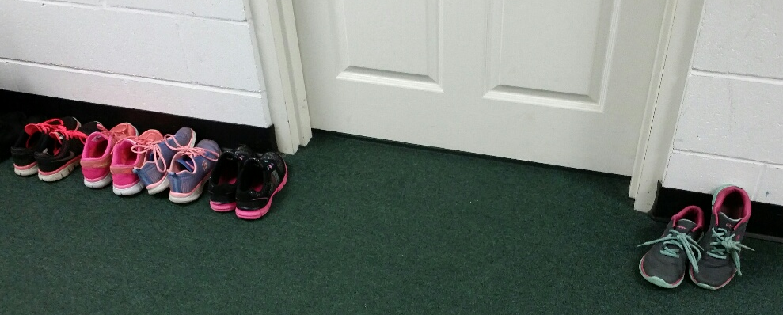
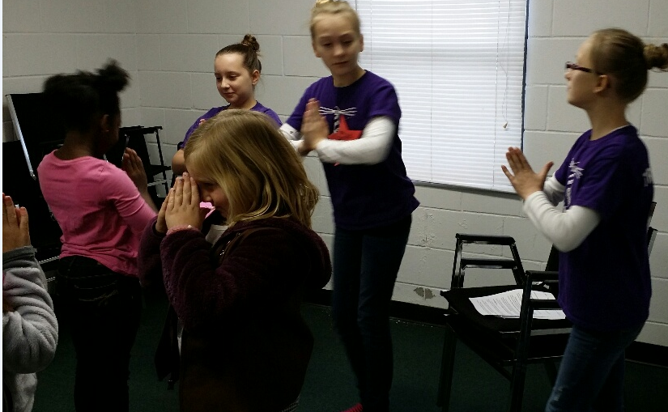
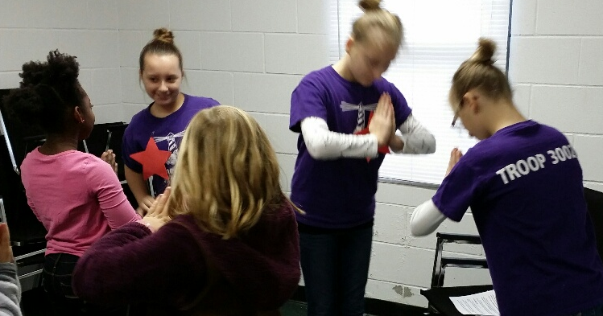
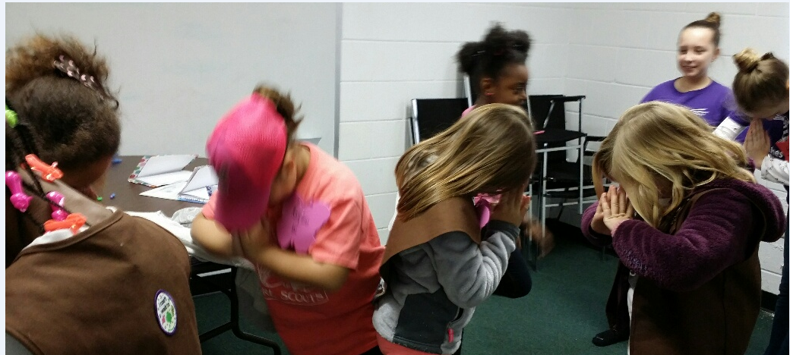
Cadette__________________________
Before we change our story, let’s learn a little more about Thailand. Shoes cannot be worn in the classrooms, homes or temples. So please take your shoes off while in this room. When Thai people greet one another, the younger person presses her hands together with her fingertips pointing up, and bows her head so that it touches her hands. This traditional greeting is called a wai. (Demonstrate and let each girl do)

Slide 20
It is also very insulting to point your foot at anyone so when people are sitting with crossed legs, they should be careful that their foot is not pointing to anyone, especially the person's head. (practice this)
And as in other parts of Asia, people give things to other people with two hands as a sign of respect. (have gifts on table, let girls present to each other)
Cadette__________________________
Thailand also is the world's largest producer of pineapples.
(hand out samples of pineapple to eat)

Slide 21
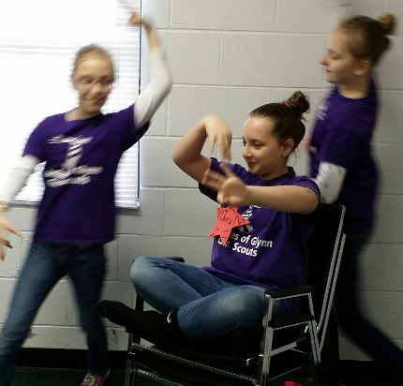
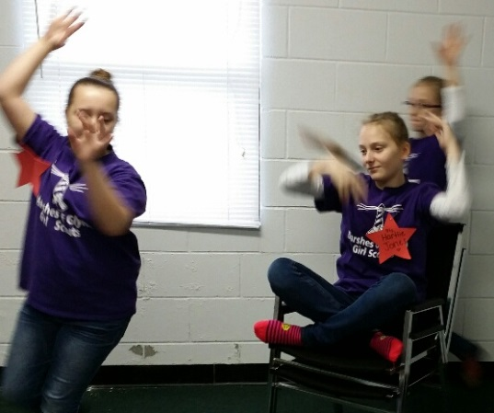
Now let’s go back to our story about Chosita’s books being soaked by the rains.
What if you went to school and all the books were damaged? What would you and your friends do about it? How can we change this story and help Chosita?
(Let the girls give ideas on how to help – change the story to make it a better world)
Cadette__________________________
Let’s learn a Thai Dance (have boom box with music – Cadettes practice ahead of time)
Thank you for visiting Thailand.

Slide 23
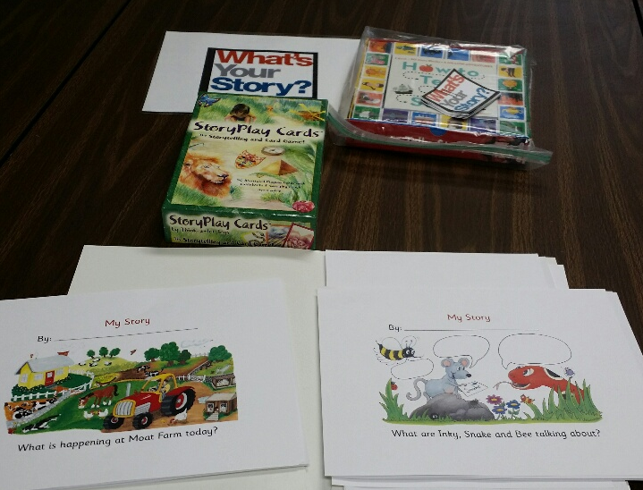
Add any Story Resources available to you.

Slide 24
The World of Girls – Tell a Story/Change a Story
Cadette:______________________________
Stories are everywhere, and so are girls! They’re in books and movies. They’re on the Web and on TV. Stories and girls are all over the world. They’re all around you, too.
Stories are the best way to explore what life is like for girls around the world. And, in stories, you can find clues about what you might do to make life better for girls, near and far!
Cadette:______________________________
Stories usually have a beginning, a middle and an end, and a challenge that the characters have to overcome.

Slide 25
For Example, (I’m going to hand out a slip of paper to each of you – let’s go around the room and have you read what’s on your paper. The last sentence will be the end of the story)
Suzie was excited about going on vacation to the Mountains
She had $20 to spend on anything she wanted
Suzie wanted to buy something really special to bring back to her grandmother.
At the store, she saw her money was missing from her purse and was so upset.
The store manager saw Suzie’s tears and asked what was wrong and Susie explained.
The store manager said, I can help look, maybe it just fell out on the floor. I’ll get other people to help look too.
Together, in just a few minutes, the $20 was found and Suzie was a happy shopper.

Slide 26
Cadette:______________________________
What was the beginning? Excited about vacation to Mountains
What was the Middle? Losing her money
What was the ending? Store manager and others helping to look and Suzie is happy!!!
Cadette:______________________________
Now, let‘s have a couple Story Relays (explain how it works) using post cards for the Girl Scout Promise and then the second relay will be a variety of words to make up a story. (will have this for Saturday)
(See Page _______in Leader’s Book)

Slide 27
Cadette:______________________________
You’ve probably heard someone say “A picture is worth a thousand words.” That’s because pictures can tell stories. Here are some pictures, what type of story do you see? There are no wrong answers.
(Go around the room (or get volunteers) to see if the girls can make up a story – it’ll have a beginning, middle and ending results.)
Ask the other girls how would they change the story ???? Does the story need changing – does the ending make the world a better place???
(Please find some pictures if you would like to do this and have ____ make up a story. Or, you can find something else in the book you would like to do.)

Slide 29
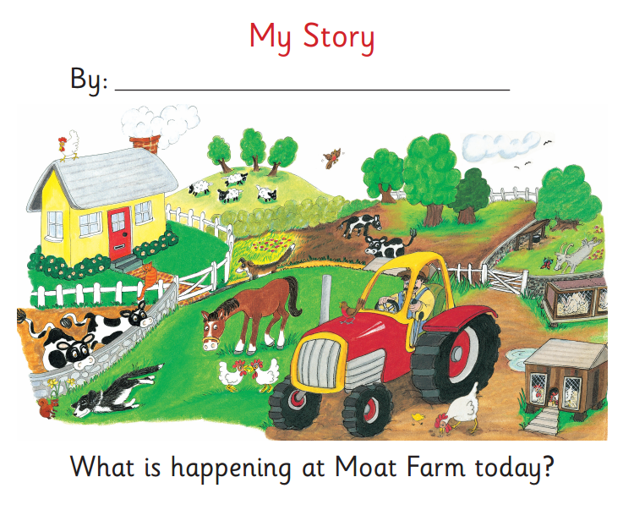
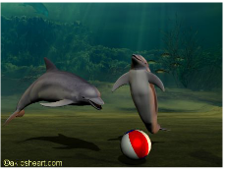

Slide 30
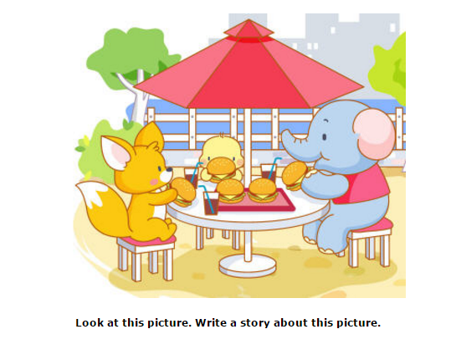

Slide 32
World of Girls
Game Time
Cadette: ______________________
Cadette: ______________________
Cadette: ______________________
Games are like stories! They play out over time with a beginning, a middle , and an end. After we play the game, we’ll talk about how this happened, and then that happened, and then it ended. That’s a story!
The Kim’s Game
Escargot – French version of hopscotch – path is spiral shape like snail.

Slide 33
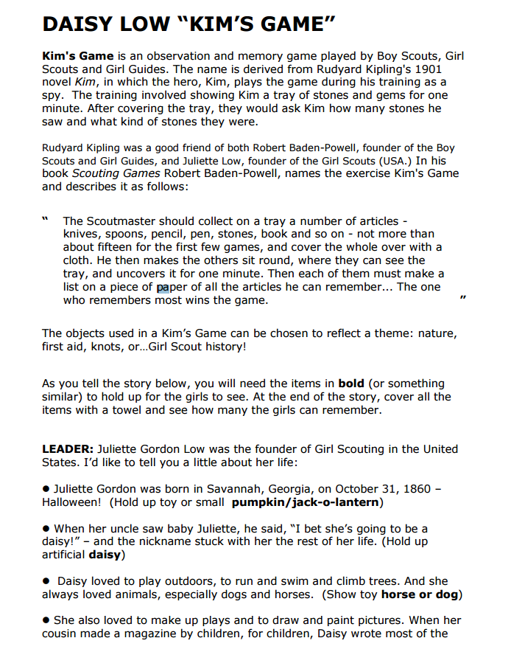

Slide 34
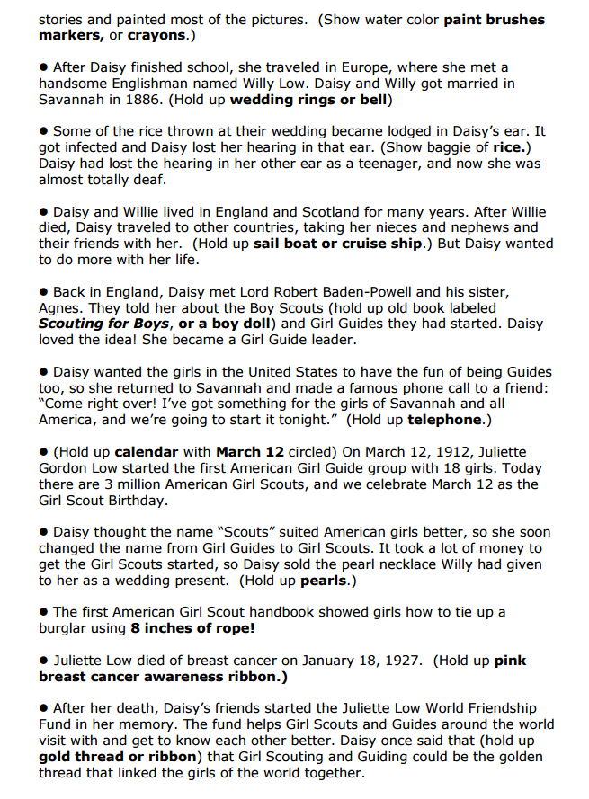

Slide 35
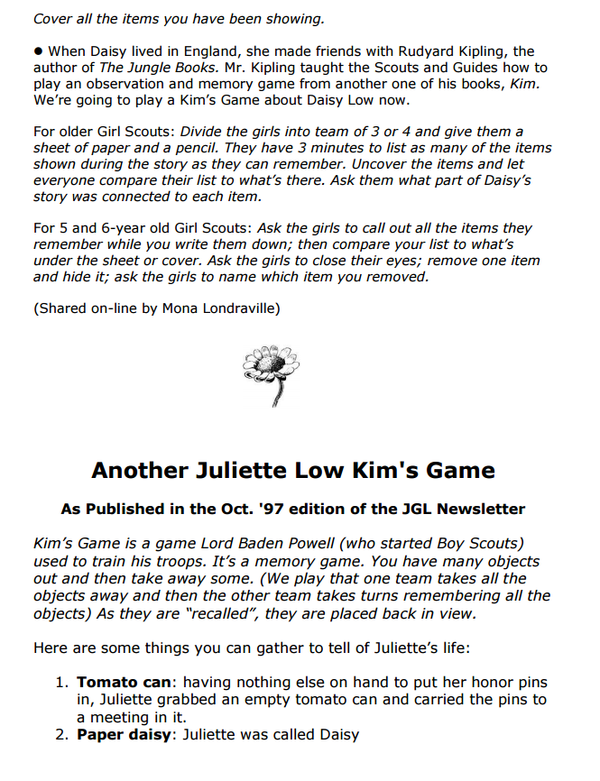

Slide 36
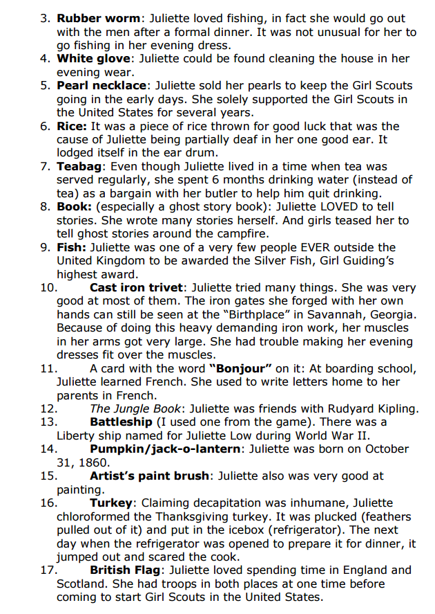

Slide 37
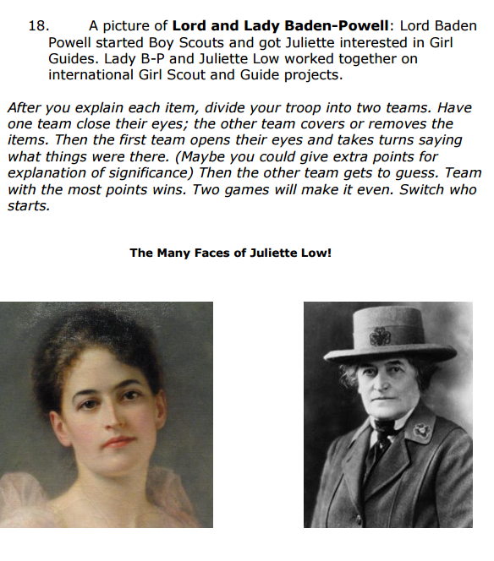

Slide 38
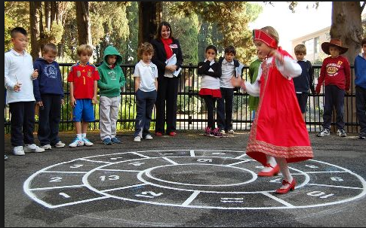
Escargot – French version of hopscotch

Slide 39
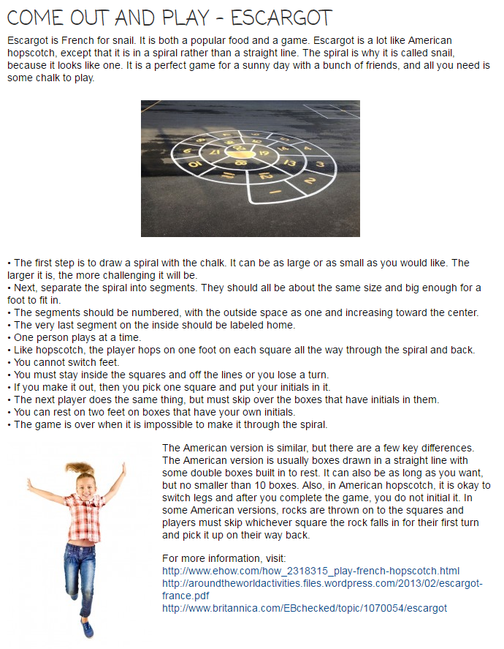

Slide 40
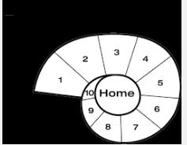

Slide 41
Resource
Appendix

Slide 42
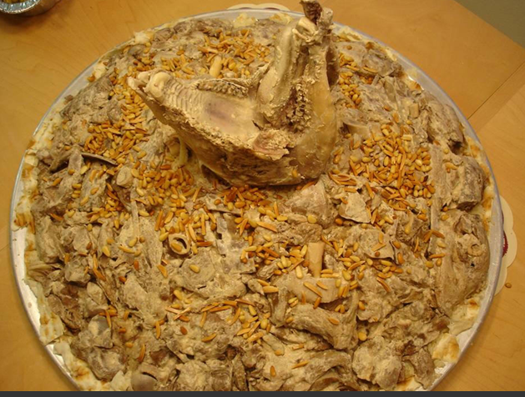

Slide 43
JORDAN

Slide 44
Thailand

Slide 45
Arctic Canada

Slide 46
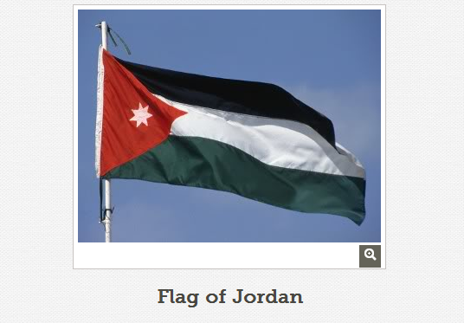

Slide 47
Flag of Thailand
Flag of Thailand
Flag of Thailand
Flag of Thailand

Slide 48
Arctic Canada Flag
Arctic Canada Flag
Arctic Canada Flag
Arctic Canada Flag

Slide 49
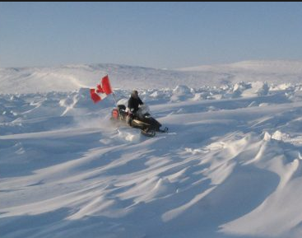
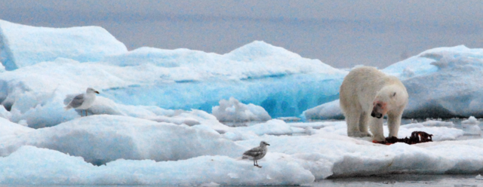
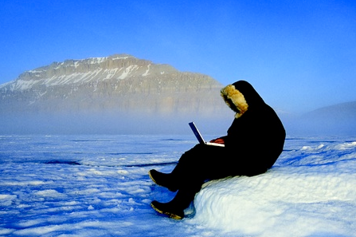
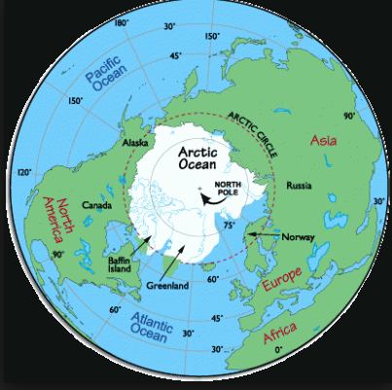
Arctic Canada

Slide 50
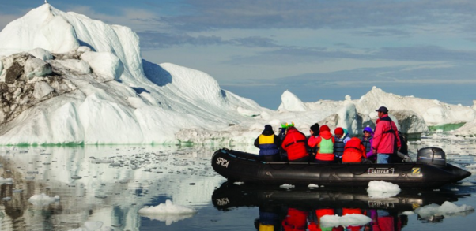
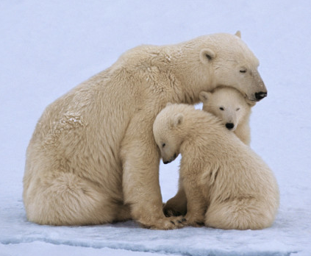
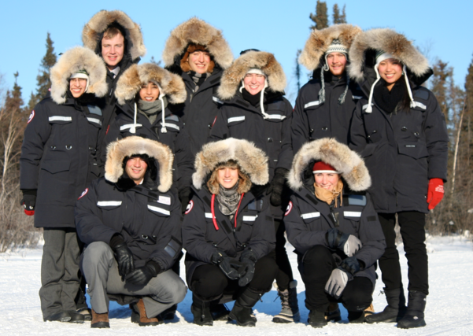
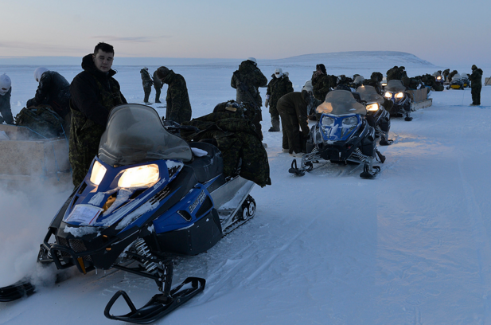
Arctic Canada

Slide 51
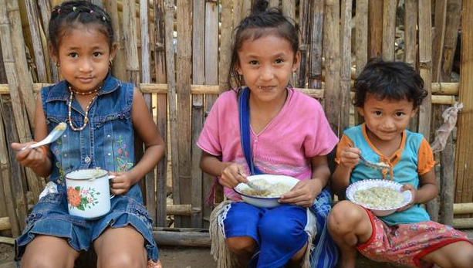
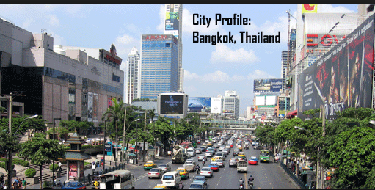
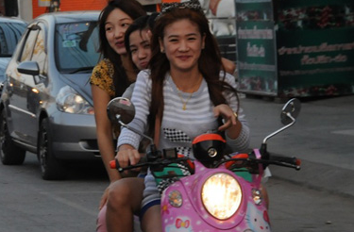

Slide 52
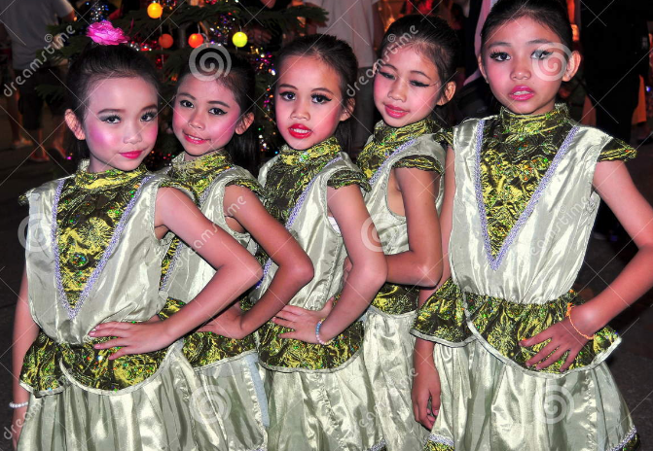
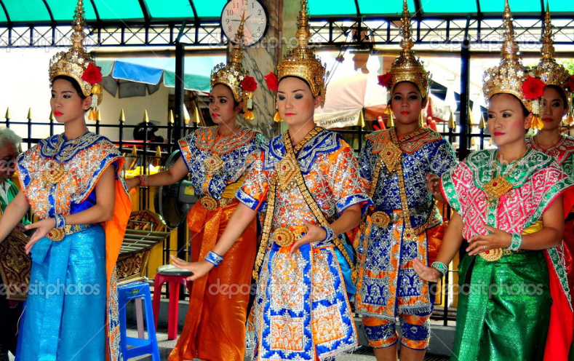
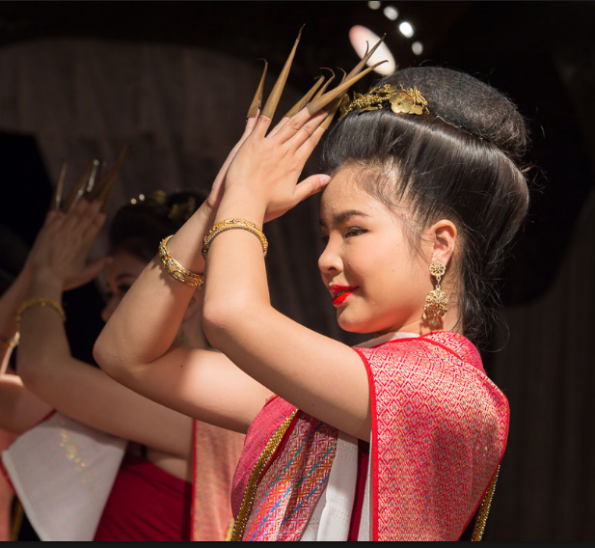
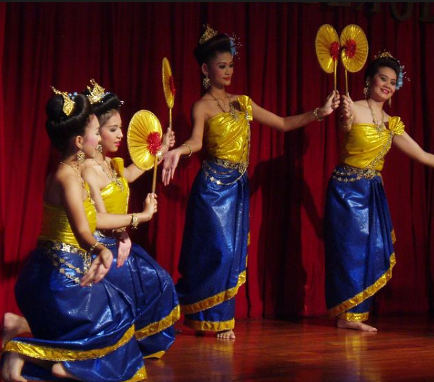
Thailand

Slide 53
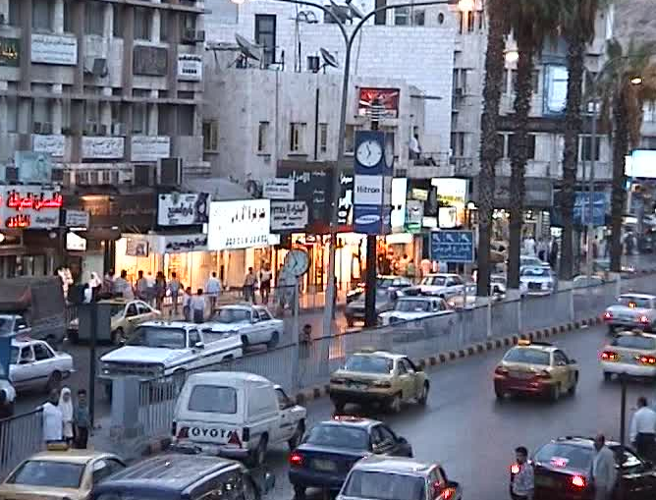
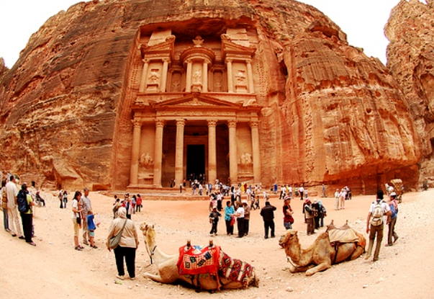
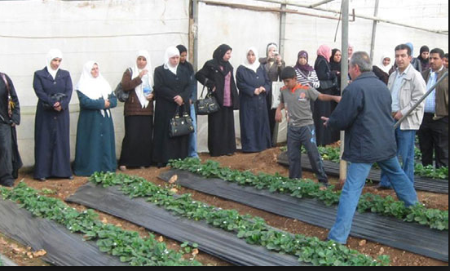

Slide 54
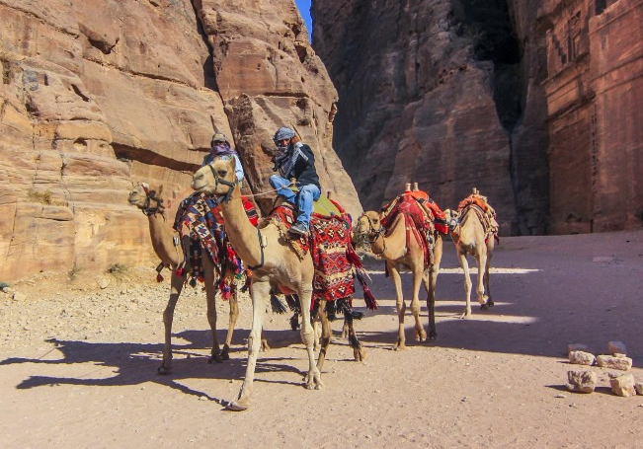
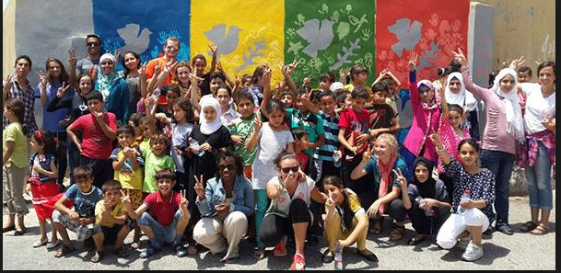
Amman Jordan

Slide 55
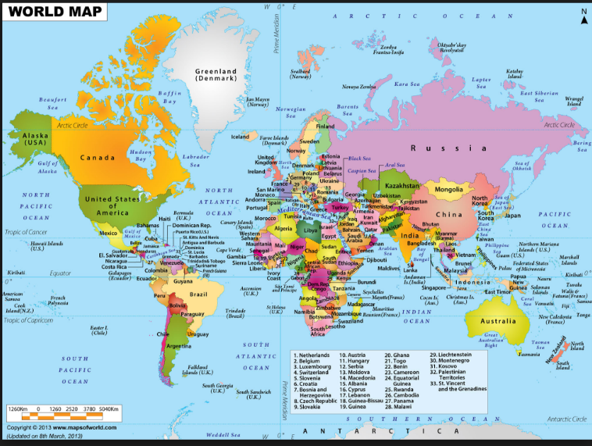

Slide 56
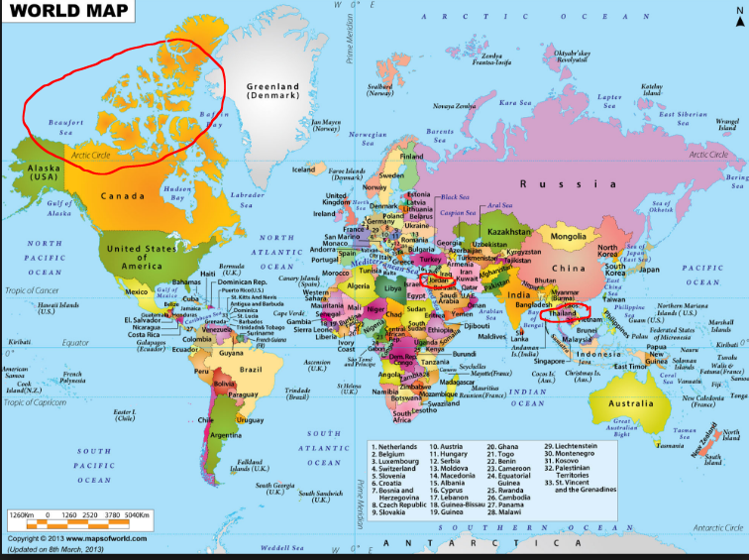

Slide 57
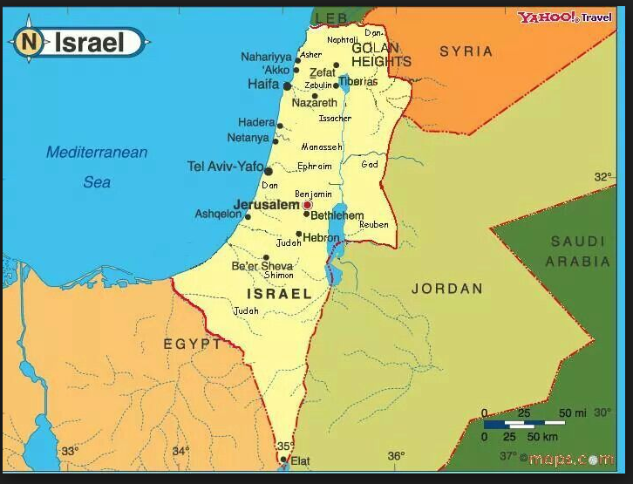

Slide 58
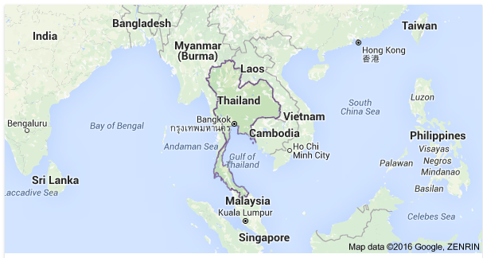

Slide 60
Brownie
World of Girls Journey Badge
Completed ______________________
is hereby granted to:
__________________
Marshes of Glynn Girl Scouts
Awarded: _____________

Slide 61
Cadette Leader in Action (LIA)
Brownie-World of Girls Presentation
Completed _______________________
is hereby granted to:
__________________
Marshes of Glynn Girl Scouts
Awarded:__________________

